Slide 1

Amazon Sales Analysis
Amazon Sales

Slide 2
Details Of DatA
Jan
Feb
Mar
Apr
May
June
July
Aug
Sep
Oct
Nov
Dec
2010
2011
2012
2013 Years Wise Sales /Month Wise Sales
2014
2015
2016
2017

Slide 3
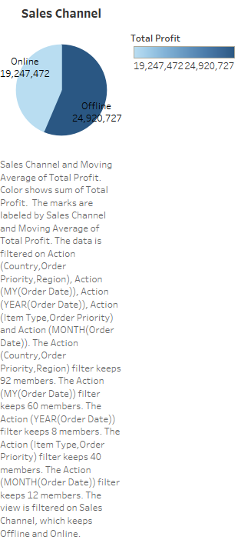

Slide 4
Main KPIS
Total Profit
Total Revenue
Total Cost
Total Sold
Sales Channel -> Online
-> Offline

Slide 5
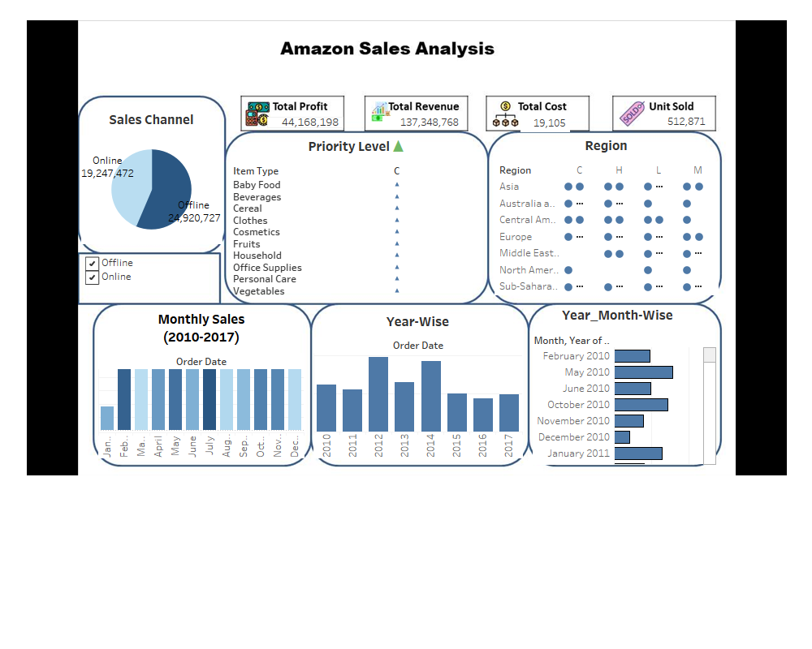
Mock – up Dashboard

Slide 6
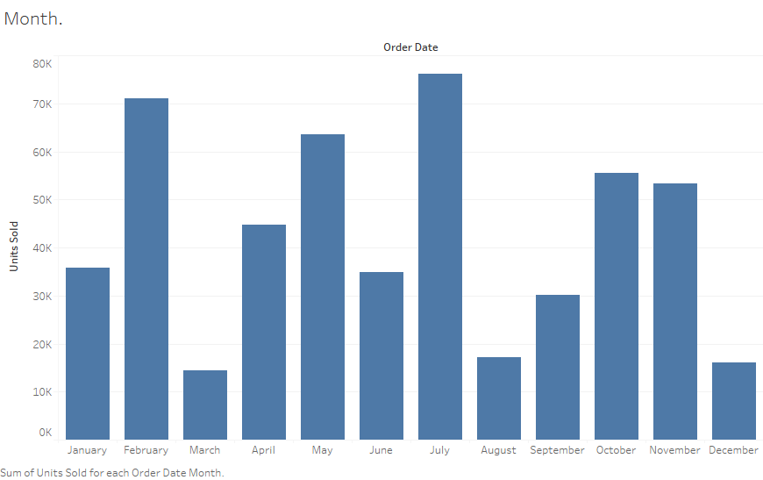
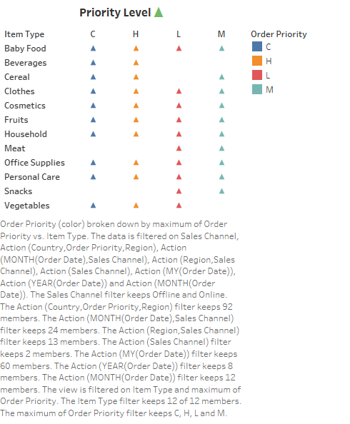
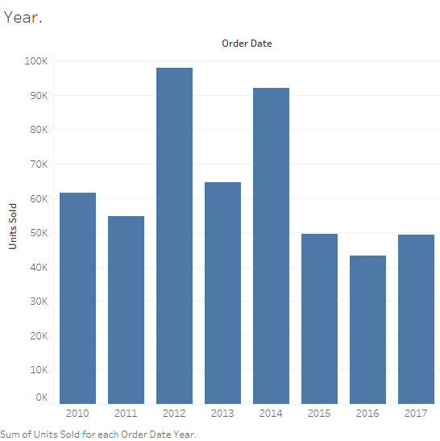
My Design

Slide 7
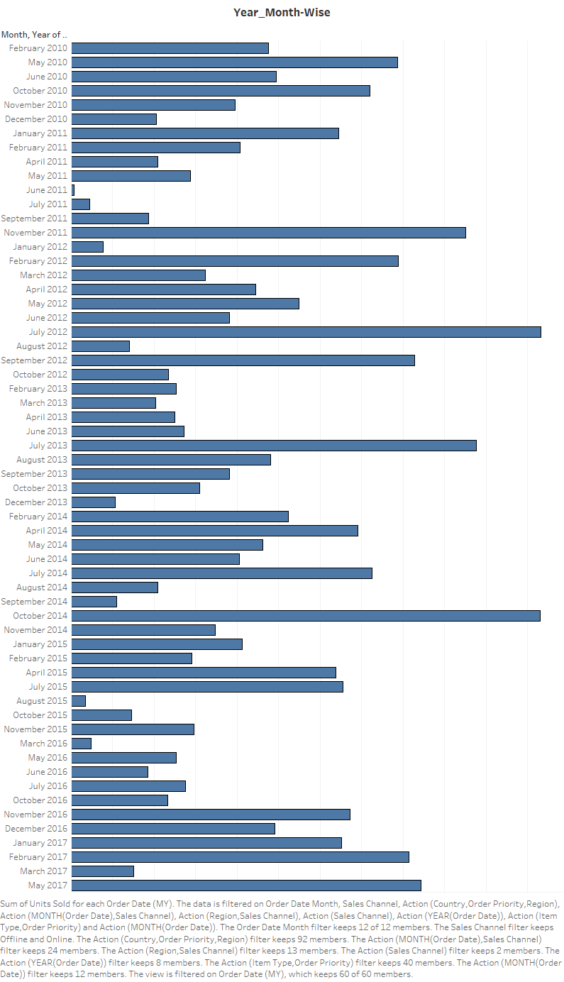

My Design

Slide 8


